Slide 1
Cloud Computing
Lecturer: Jackie Stewart
Room: X309
Email:
jackie.stewart@tus.ie
9-<number>

Slide 2
What we will cover next:
What is cloud computing
Five main principles that define cloud computing
Characteristics of Cloud Computing
Cloud Architecture Service Model
Various Cloud Deployment Models
Virtualisation and its many different types
Advantages of Cloud Computing
The challenges faced by Cloud Computing

Slide 3
Overview
Cloud computing is the delivery of computing and virtualized IT services – (such as databases, networking , software, servers, analytics, and more) – through the Internet to provide a flexible, secure, and easy-to-use environment
Cloud native technology is driving the modern revolution of build, run, manage, monitor and secure modern applications on the cloud
Cloud microservices is part of modern applications
Every organization is building a new design or migrating from the legacy monolithic design to modern microservice applications using cloud native technology
Microservices and containers are new buzzwords for application and infrastructure, respectively.

Slide 4
What is Cloud Computing
IBM “Cloud computing is on-demand access, via the internet, to computing resources—applications, servers (physical servers and virtual servers), data storage, development tools, networking capabilities, and more—hosted at a remote data center, managed by a cloud services provider (or CSP). The CSP makes these resources available for a monthly subscription fee or bills them according to usage.”
Google Cloud“Cloud computing is the on-demand availability of computing resources as services over the internet. It eliminates the need for enterprises to procure, configure, or manage resources themselves, and they only pay for what they use.”
Amazon (aws) “Cloud computing is the on-demand delivery of IT resources over the Internet with pay-as-you-go pricing. Instead of buying, owning, and maintaining physical data centres and servers, you can access technology services, such as computing power, storage, and databases, on an as-needed basis from a cloud provider”

Slide 5
What is Cloud Computing
All these different statements could be and are summed up in [Rhoton]:
“A large pool of easily useable and accessible virtualized resources (such as hardware, development platforms and/or services)”
These resources can be dynamically reconfigured to adjust to a variable load (scale), allowing also for optimum resource utilization
This pool of resources is typically exploited by a pay-per-use model in which guarantees are offered by the Infrastructure Provider via Service Level Agreements (SLA’s)

Slide 6
Introducing Cloud
Cloud has been a game-changer in the digital world, creating an entirely new dimension for business operations and collaboration ..read further…. (reference to this article is below the slide).
“Two frequently misinterpreted terms are “Cloud-native” and “Cloud-based” applications
What is a cloud-native app?
These are apps that are built, designed, and managed for the cloud. Designed from the ground up to operate in the cloud, enabling seamless accessibly and scalability by developers quickly.
Usually built using a microservices architecture, which makes it easy for changes to be made to specific modules
What is a cloud-based application?
Cloud-based applications are apps that leverage the availability and scalability capabilities of the cloud – without undergoing a complete rebuild or redesign.
These are apps which exist on-premise that have been moved to the Cloud – not built for it.”
Notes:
Cloud has been a game-changer in the digital world, creating an entirely new dim ..
Read more at:
https://cio.economictimes.indiatimes.com/news/cloud-computing/cloud-native-apps-vs-cloud-based-applicationsyes-theres-a-difference/89170585
“Cloud applications, whether cloud-native or cloud-based, benefit from the core advantages of cloud computing.
What makes them different is the underlying design: while cloud-native apps are developed especially to run in the Cloud;
Cloud-based applications are traditional applications that have been appropriately adapted for operation in the Cloud.”

Slide 7
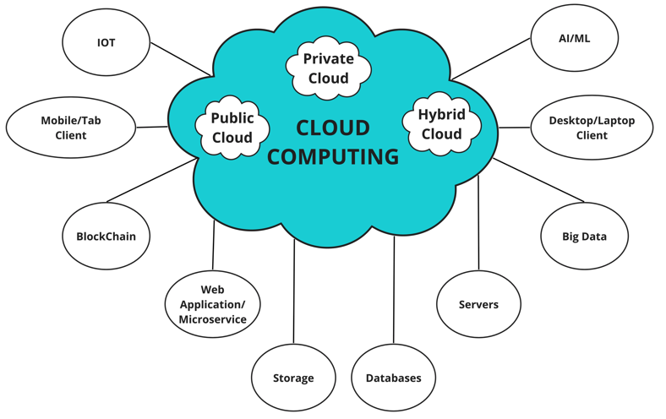
Introducing Cloud
Cloud Computing software and hardware modules

Slide 8
Introducing Cloud
Cloud computing is the on-demand availability of computer system resources, especially memory, data/cloud storage and CPU computing power, without manual management by the user
Clouds may be limited to a single organization (enterprise clouds) on their on-premises or be available to many organizations (public cloud) on the internet
Clouds provides smooth experience on their platform with faster response, no outage, and highly available environment

Slide 9
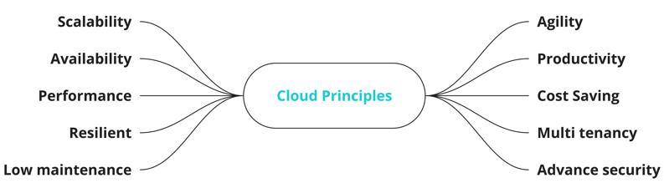
Cloud principles
Cloud has built on these main principles – Lets discuss!

Slide 10
Cloud principles
Scalability: provides auto-scalability of the applications and infrastructure
Availability: business apps cant afford outage, cloud provides high availability (HA)- applications are deployed on multiple distribution environments –data centres (DCs) and availability zones (AZs)
Performance: cloud computing offers high-performance servers and super fast SSD drives
Resilient: Cloud environment is self-healing with advance recovery mechanism. Microservices apps are easily recovered and restored automatically
Low Maintenance: Cloud services automate all cloud maintenance
Agility: agility to build, run and manage application and to launch to market quickly
Productivity: increase developer and DevOps operators productivity
Cost Saving: Cloud provides low cost infrastructure – Pay per usage!
Multi tenancy: Cloud facilitates deployment of the same ap on multiple servers and balance the load. Multiple customers and applications can share the computing resources but keeping their data separately with added security
Advance Security: Cloud provides advanced security to protect an organizations applications, infrastructure and data.
Notes:
SSD (Solid State Drive) a storage device.

Slide 11
Five Main Principles that define Cloud Computing
Five main principles that define cloud computing:
1: Pooled computing resources available to any subscribing users
2: Virtualized computing resources to maximize hardware utilization
3: Elastic scaling up or down according to need
4: Automated creation of new virtual machines or deletion of existing ones
5: Resource usage billed only as used.
Notes:
Pooled resources – Available to any subscribing users
Virtualization – High utilization of hardware assets
Elasticity – Dynamic scale without CAPEX
Automation – Build, deploy, configure, provision and move all without manual intervention
Metered billing – Per usage business model; pay only for what you use.

Slide 12
Characteristics of Cloud Computing
On demand self service provisioning
  Consumer can provision computing capabilities, without requiring human interaction with each service provider.
  Cloud functionality is available as a service
Standard network access
  Capabilities are available over the network and accessed via standard mechanisms ( e.g. mobile phones, workstations)
Pooled and scalable resources
  Pooled resources are available for any authorized access.
  Resources can be scaled up or down very quickly to meet customers demand
  The pooling of resources across customers is an import factor
Flexible billing, pay as you use, providers bill customers based on resource usage.

Slide 13
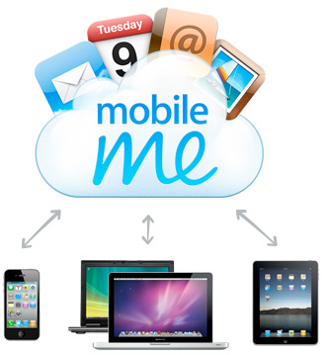
Cloud Computing from a personal user perspective
From a personal user perspective
Any Service on Any Device any Where any Time
How many of the applications we use are actually installed on our local machines?

Slide 14
Cloud Computing from A Business Perspective
From a business perspective:
Cloud computing has made significant impact on business strategy.
Changed model of financing IT expenditures by replacing capital expenditure with operational expenditure => reduction in fixed cost
Universal Access
Scalable services – Infrastructure – Elasticity
New Application Service Models – Pay as you Use

Slide 15
Cloud Computing – From a Technology Perspective
Main impact – enablement of new service delivery models
New platforms are easily available to developers
Utility priced infrastructure – dev, test, deploy
Mobile technologies are well supported by cloud computing – rendering of video / processing in the cloud with rendering on mobile
Processors: - Virtualization & memory management
network virtualization
Disk – storage virtualization & improved scaling capacity
Notes:
The recent technological breakthrough that enabled high utilization on commodity hardware – and which is the single biggest factor behind the cloud being a recent IT phenomenon – is Virtualization where each physical server is partitioned into many virtual servers.
Each one acts like a real server that can run an operating system and a full complement of applications.
Virtualized servers are the primary units that can be consumed as needed in the cloud.

Slide 16
Quick List - Business Benefits of Cloud
Can you name any benefits?
Smoother and faster app user experience
On demand scaling for infrastructure
24*7 high availability
Less operational cost
Easy to manage – cloud provides Paas & Iaas
Release app features quickly to compete in the market
Increased security
Increased developer productivity
Modular teams
Public clouds pas as you go usage policy
Easy disaster recovery handling
Etc…

Slide 17
Cloud Classification – as a service!
Cloud Classification
IAAS
  Infrastructure as a Service
CAAS (for cloud native apps)
  Container as a Service
PAAS
  Platform as a Service
FAAS (allows execution of microservices)
  Function as a Service
SAAS
  Software as a Service
DAAS (subset of SaaS – provides databases as a service)
  Database as a Service
Notes:
Infrastructure as a Service (IaaS)—
Infrastructure is the infra layer that provides a platform of Operating System(OS),
Compute services, memory and persistence storage. It provides IP-based connectivity
Using TCP/IP, UDP and REST API services. It provides a bare-metal (BM) platform
Where applications can be deployed
– ie: IaaS platforms include AWS (EC2), Azure Virtual Machines, Google Compute
Engine, and Kubernetes.
USE CASE: Organization wants to manage their infrastructure on their own from the hardware
Layer to OS and runtime.
Container as a Service (CaaS)—
Container is a new IaaS for cloud native modern applications
An intermediate model between the IaaS and the
PaaS, it refers to a form of container-based virtualization.
Container is an executable unit/bundle of software in which application binary code is
Packaged. CaaS provides a platform to deploy, run, and manage software applications as containers.
USE CASE: Run apps on smaller containers on top of bare-metal/hypervisor infrastructure.
Platform as a Service (PaaS)—This model provides a platform and an environment
that allow users to focus on the development, execution, and maintenance
of the application. The applications can be created with tools that are
provided by the vendor (for example, operating system, database management
systems, technical support, storage, hosting, network, and more). Users do not
need to invest in a physical infrastructure, nor spend time managing it, allowing
them to concentrate exclusively on the development of applications.
PaaS platforms include Google App Engine, Cloud Foundry, Heroku, and
AWS Elastic Beanstalk
USE CASE: Faster release to compete in market.
No vendor lock-in for backend and middleware software on cloud, because
same PaaS software platforms manage your apps, database, and infra on
multi-clouds on private, hybrid and public clouds –
ie: Amazon AWS, Google GCP and Microsoft Azure.
Function as a Service (FaaS)—
Provides a platform where service providers manage all the servers
infrastructure automatically for organizations by using an event driven model.
Its an on-demand with managed services that allows execution of microservices
through API. Public cloud charges pay as you go. FaaS saves infrastructure cost by
Only spinning servers for a shorter duration on demand, for example executing a batch
Job at a scheduled time or short-lived services. It hides all infra-abstractions.
USE CASE: good choice for short-lived microservices, good for event driven microservices
architecture model.
Software as a Service (SaaS)—
Provides ready to use software on cloud on the internet based on subscription.
Many suppliers(business) are doing business by deploying these software on cloud and
Exposing them to end users on paid subscription.
Ie: Google services like Google search, google drive, Microsoft office 360, zoom etc.
USE CASE: subscription based cloud services. Ready made services like e-mail service using MailChimp.
Database as a Service –
It’s a subset of SaaS that provides SQL/NoSQL databases as a service on cloud through the internet.
It provides strong security, performance backup, easy scalability, database upgrades,
Its also called managed services, deployed on the cloud and accessed via REST APIs.
Ie: AWS RDS is a popular database as a service.
USE CASE: outsource database to avoid operational and scaling cost.

Slide 18
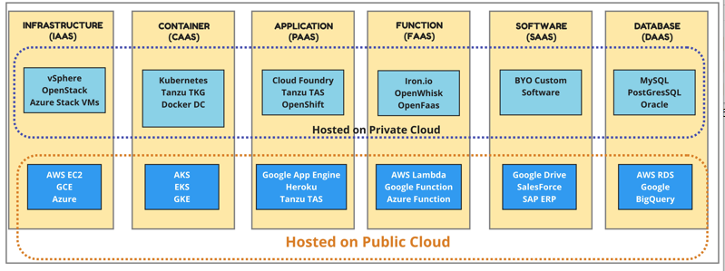
Cloud Classifications
Cloud Classification with some related reference technologies and services of service providers

Slide 19
Cloud Architecture - Service Model-with a focus on the main three
Cloud functionality is available as a Service
SPI (Software-Platform-Infrastructure) model is the most common cloud computing service model:
  Software as a Service (SaaS)
  Platform as a Service (PaaS)
  Infrastructure as a Service IaaS)
Notes:
On the software side of the cloud evolution are three important threads of development: Virtualization, SOA, and SaaS. Two are technological based and the third is business model based.
SOA (Service Oriented Architecture): is the second software concept necessary for cloud computing. SOA is seen as a logical extension of browser-based standardization applied to machine to machine communication.
SaaS we will talk about later.

Slide 20
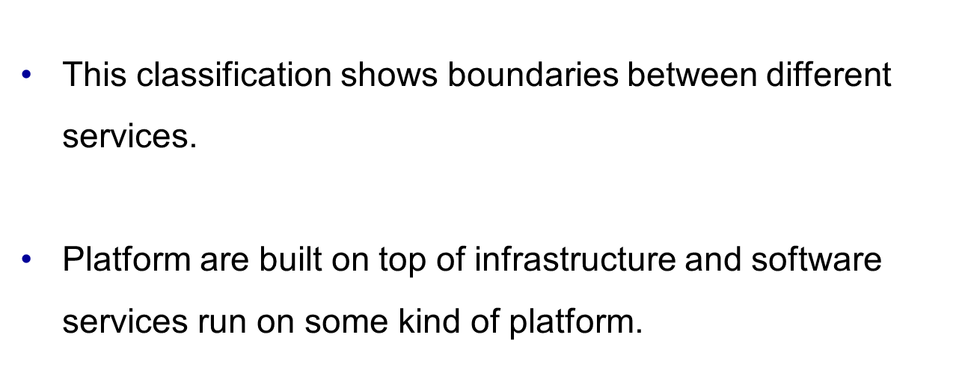
Cloud Architecture – SPI Model
Software As a Service (SaaS)
Platform As a Service (PaaS)
Infrastructure as a Service (IaaS)
Notes:
We can classify cloud computing several ways. Here we present the taxonomy where cloud services are described generically as “X as a Service”, where X can take on values such as Hardware, Infrastructure, Platform, Framework, Application and even Datacenter.
SPI is the most common cloud computing service model:
SAAS : Software as a service
PASS : Platform as a service
IAAS : Infrastructure as a service

Slide 21
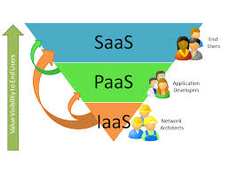
Cloud Architecture - Service Model
SaaS – Applications used by end user
At the SaaS level, user is subscribing to specific software
or a service
PaaS – Primarily a development platform for developers.
Developers have support to develop test and deploy
applications. PaaS have been developed to facilitate faster time-to-
market, a common user experience and an easier development
environment.
IaaS – Infrastructure : provides server, storage, network
components . Provides scalable computing resources
Notes:
SaaS (e.g. Salesforce) is a software distribution model in which applications are hosted by a service provider This is then made available to customers over a network typically the Internet.
PaaS (e.g. Google App Engine) is a paradigm for delivering operating systems and associated services over the Internet. This is delivered without downloads or installations
IaaS involves outsourcing the equipment used to support operations including storage, hardware, servers and network components

Slide 22
Cloud Architecture -SPI model
Software as a Service (SaaS) : is a software distribution model in which applications are hosted by a vendor or service provider and made available to customers over a network, typically the Internet.
Platform as a Service (PaaS) : The capability provided to the consumer to deploy onto the cloud infrastructure consumer-created or acquired applications using programming languages, libraries and tools provided by the provider. The consumer does not manage or control the underlying cloud infrastructure but has control over the deployed applications.
Infrastructure as a Service (IaaS) : involves outsourcing the equipment including storage, hardware, servers and networking components without the need for capital investment.

Slide 23
Cloud Architecture -SPI model
Software as a Service (SaaS) : is a software distribution model in which applications are hosted by a vendor or service provider and made available to customers over a network, typically the Internet.
    Software Services are typically highly standardized and tuned for efficiency.
You will often find that some “services” are “between” classification.
Notes:
SaaS – is a recurring subscription based model delivered to the customer on demand (pay as you use). – ie: Accountancy program for a business.
This is a layer ontop of PaaS.
Why SaaS – no up front expenses, just need a web browser to access application, no other hardware purchase of software installation is necessary. Up grades are applied directly at the SaaS suppliers end.
Examples: Gmail, yahoo, facebook, Google Apps and Microsoft Office 365

Slide 24
Cloud Architecture -SPI model
Platform as a Service (PaaS) : The capability provided to the consumer to deploy onto the cloud infrastructure consumer-created or acquired applications using programming languages, libraries and tools provided by the provider.
The consumer does not manage or control the underlying cloud infrastructure but has control over the deployed applications.
Google App Engine is considered to be Platform as a Service.
  A web application development framework and hosting solution rolled into one, That uses the infrastructure available at Google
  Flexible frameworks with few constraints and can accommodate some degree of optimization
Notes:
PaaS – it’s a computing platform which would include your operation system – a database and a web server.
Is a layer on top of IaaS – Java run times, MySQL, Oracle, and tom cat web server.
Example – Windows Azure, google App Engine and Apache Stratos.

Slide 25
Cloud Architecture -SPI model
Infrastructure as a Service (IaaS) involves outsourcing the equipment used to support operations, including storage, hardware, servers and networking components.
Public Cloud – Azure, Amazon Elastic Computer Cloud, EC2, is a classic example of Infrastructure as a Service.
  Elastic Cloud Computing
  Virtual servers for rent, called Amazon Machine Images (AMIs)
  priced on per hour
  Infrastructure services – very flexible
Notes:
The lowest layer of XaaS is known as IaaS – or sometimes as Hardware as a Service.
IaaS - Infrastructure as a Service – deals with virtual machines, storage which is hard disk, servers, network load balancer etc.
Storage and bandwidth are also consumable commodity in an IaaS environment, with storage typically charged per gigabyte per month and bandwidth charged for transit into and out of the system.

Slide 26
Different Types of Cloud
Three different Deployment Models:
  Public
  Private
  Hybrid
Notes:
Private clouds are a variant of generic cloud computing where internal data-center resources of an enterprise or organization are not made available to the general public – these pooled computing resources are actually not available to any subscribing users but are instead controlled by an organization for the benefit of other members of that organization.
The public clouds of providers such as Amazon and Google were originally used as private clouds by those companies for other lines of business (book retailing and internet search).
Hybrid clouds combine private and public clouds. You can use them in cases where the capacity of a private cloud is exhausted and excess capacity needs to be provisioned elsewhere.

Slide 27
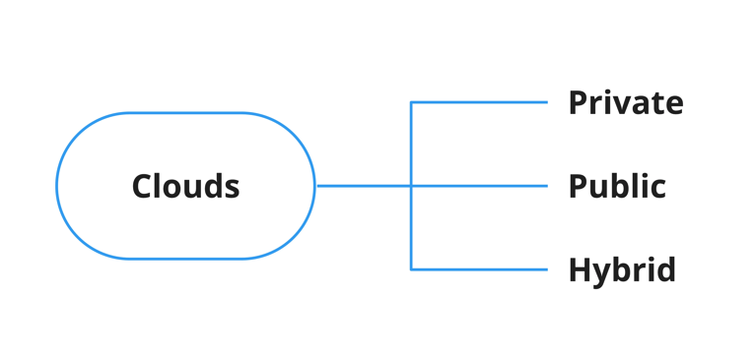
Types of Cloud
Private/on-prem cloud
  Maybe hosted on an organizations site(on-prem) or private workspace on the public cloud service providers
Public cloud
  completely hosted on a public cloud service provider
Hybrid clouds
  combination of private and public cloud

Slide 28
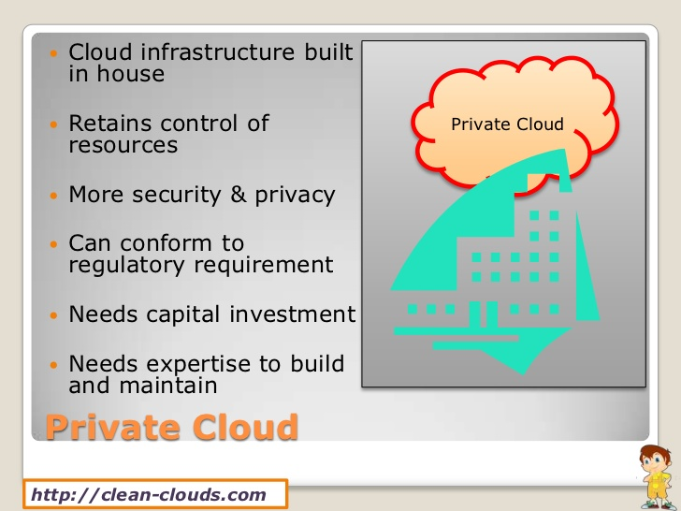
Cloud Computing - Private Deployment
The cloud infrastructure is provisioned for exclusive use by a single organisation comprising of multiple consumers
It may be owned, managed and operated by an organisation , a third party, or combination of them
It may exist on or off the premises

Slide 29
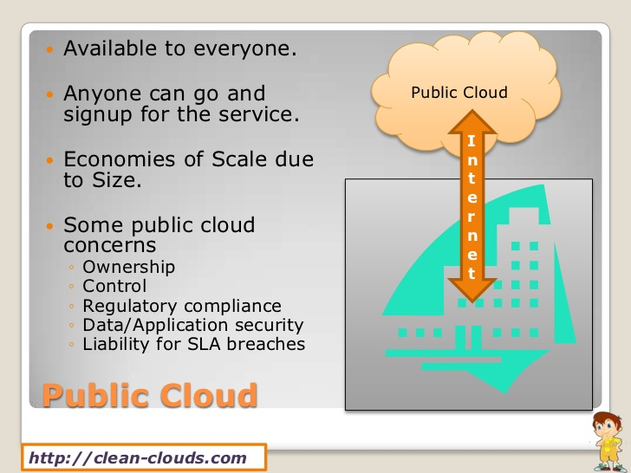
Cloud Computing –Public Deployment
The cloud infrastructure is provisioned for open use by the general public.
It may be owned, managed and operated by business, academic or governmental organisation.
It exists on the premises of the cloud provider.

Slide 30
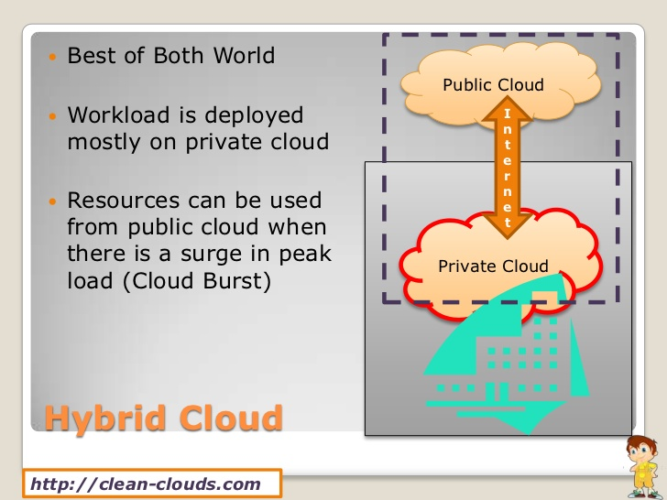
Cloud Computing - Hybrid
This cloud infrastructure is a composition of public and private infrastructure that remain unique identifies, but are bound together by standardized or proprietary technology that enables data and application portability ( e.g. load balancing between clouds).

Slide 31
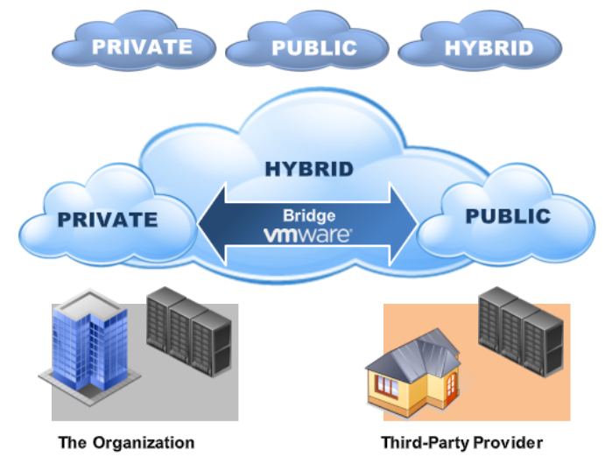
Cloud Computing

Slide 32
Virtualization
Virtualization: Cloud Services are often offered through an abstracted infrastructure
The aim is to achieve cost optimization through multi-tenancy(multiple users using the same physical hardware)
Virtual machines (VMs) are the heart and soul of the major cloud providers
Virtualization (or virtualisation) is the creation of a virtual (rather than an actual) version of something, such as a hardware platform, operating system (OS), storage device, or network resources
Notes:
The second of the five main principles of cloud computing has to do with virtualization of compute resources.
Virtualization is vital to the cloud because the scale of cloud infrastructures has to be enormous, based on thousands of servers.
Each server takes up physical space and uses significant power and cooling.
Getting high utilization out of each and every server is vital to be cost effective.
Virtualization allows physical hardware (like servers) to be divided into multiple virtual machines (VMs) or containers.
Each virtual environment operates as if it were a separate, independent server, with its own operating system, applications, and resources.
A hypervisor (software) or container engine (like VMware, Hyper-V, or Docker) manages the virtualization process by abstracting the hardware and allocating resources to these virtual environments.
Multi-tenancy in a virtualized environment means that multiple users or tenants can run their own applications, operating systems,
and workloads on the same physical hardware.
Each tenant's data, configurations, and resources are logically separated to ensure security and privacy, even though they share the same physical infrastructure.
This is often used in cloud environments, where different organizations or customers rent virtual resources (VMs or containers) from a cloud provider.

Slide 33
Virtualization
Virtualization in cloud computing refers to the practice of creating virtual instances of computing resources, such as servers, storage, and networks, to efficiently utilize physical hardware
This provides scalability, flexibility, and resource isolation in a cloud environment.
This technology plays a fundamental role in enabling cloud services to deliver on-demand computing resources to users.
Two different technologies that create virtual instances of computing resources are cloud virtualization (resources managed and made available in remote data centres operated by cloud service providers) and local (on-premises/private) virtualization (virtualization on physical hardware within an organizations own infrastructure)

Slide 34
Virtualization
Many different types of virtualization:
  Hardware virtualization
  Desktop Virtualization
  Operating system Virtualization
  Storage Virtualization
  Network Virtualization

Slide 35
Virtualization
Desktop virtualization is the concept of separating the logical desktop from the physical machine.
Operating system-level virtualization, hosting of multiple virtualized environments within a single OS instance.
Storage virtualization, the process of completely abstracting logical storage from physical storage.
Network virtualization, creation of a virtualized network addressing space within or across network subnets
Notes:
Platform Virtualization is a technique to abstract computer resources such that it separates the operating system from the underlying physical server resources.
Instead of the OS running on hardware resources, it interacts instead with a new software layer called a virtual machine monitor that accesses the hardware and presents the OS with a virtual set of hardware resources.
This means multiple virtual machine images or instances can run on a single physical server and new instances can be generated and run on demand, creating the basis for elastic computing resources.

Slide 36
Advantages of Cloud Computing
Lower costs
Enhanced agility in terms of scalability and deployments
Simplified operation and maintenance
Improved resilience
Trusted collaborations
Fast deployment

Slide 37
Challenges facing the “Cloud”
Continuous high availability
Consistency
Latency –
Scalability
Security and data secrecy
Performance
Mindset
Data location – impact of legal!!!
Recovery

Slide 38
In the next set of slides (Lecture 3.2), we will explore Virtualization and Hypervisors in greater detail along with Virtual Machines (VMs)

